Slide 1
Lecture 3 Describing and Visualizing Distributions

Slide 2
Review
1 What is a statistic?
A numerical characteristic of a sample – a number computed from the observations we actually collected.
2 What is a parameter?
The same kind of number for a population, computed from every observation – and usually unknown.
3 What do we use data for?
To answer questions about a population.
4 What is a population?
The set of all observations of interest – observed and unobserved.
5 What is a sample?
The subset of the population that we actually observe.

Slide 3
Review
1 What do we call the way we collect the data?
The sampling design.
2 What are the three arms of statistics?
Design, description and inference.
3 Which one comes first, and why?
Design – how we plan to collect the data, settled before any data exists. No amount of description or inference repairs a bad design.
4 What is an estimate?
A statistic computed from a sample, used to approximate an unknown population parameter

Slide 4
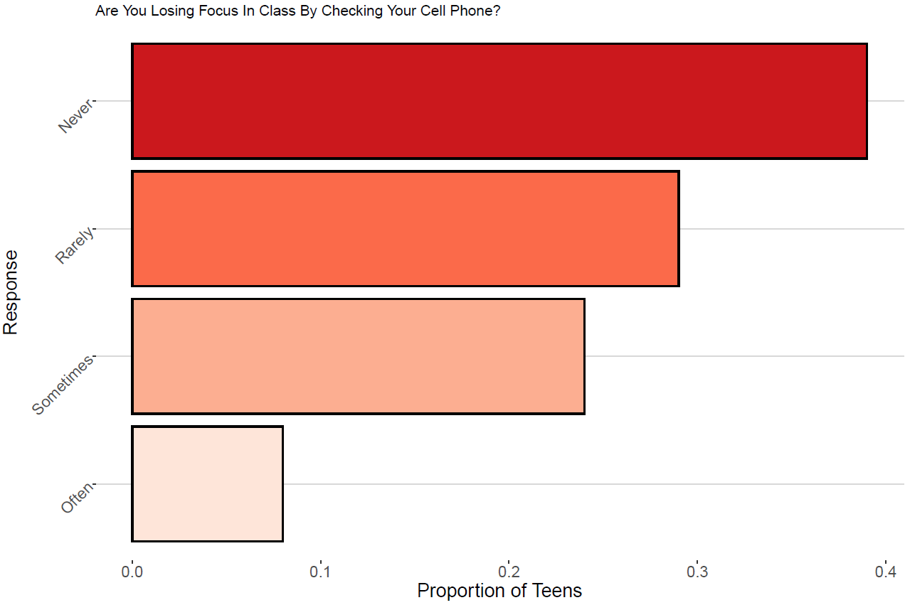
Where we stopped on Friday: the teen cell-phone survey

Slide 5
Features of Distributions
A distribution of a variable gives (a) the values that occur and (b) how often each value occurs
Features of A Distribution
Categorical Variables:
Modal category – the category with the highest frequency
Quantitative Variables:
Shape – do observations cluster into certain areas, are values spread out or more densely packed together?
Center – where is the middle point on the distribution, where does a typical value fall?
Variability – how tightly to observations cluster around the center of the distribution

Slide 6
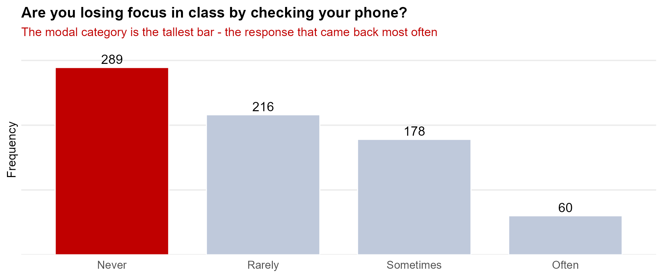
What to Look For: the Modal Category
Modal category – the category with the highest frequency. It is the feature we describe for a qualitative variable.
Never is the modal category. There are no numbers to average here, so the modal category is the whole summary – which is why shape, center and variability are reserved for quantitative variables.

Slide 7
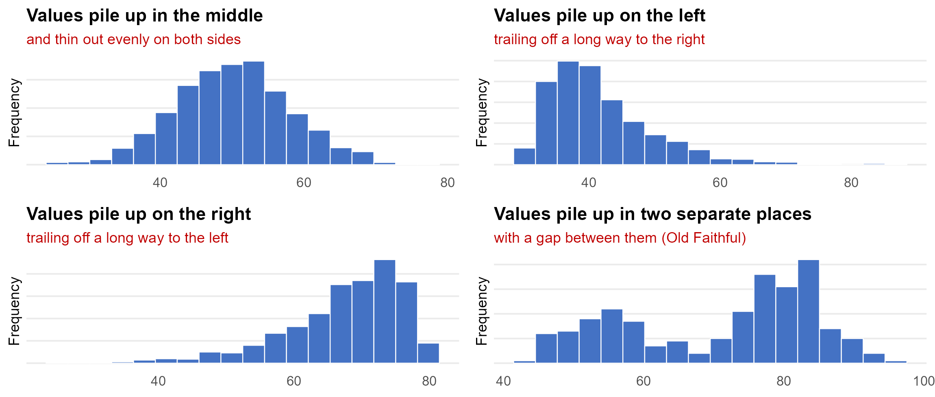
What to Look For: Shape
Shape – do observations cluster into certain areas? Are the values spread out evenly, or piled up on one side?

Slide 8
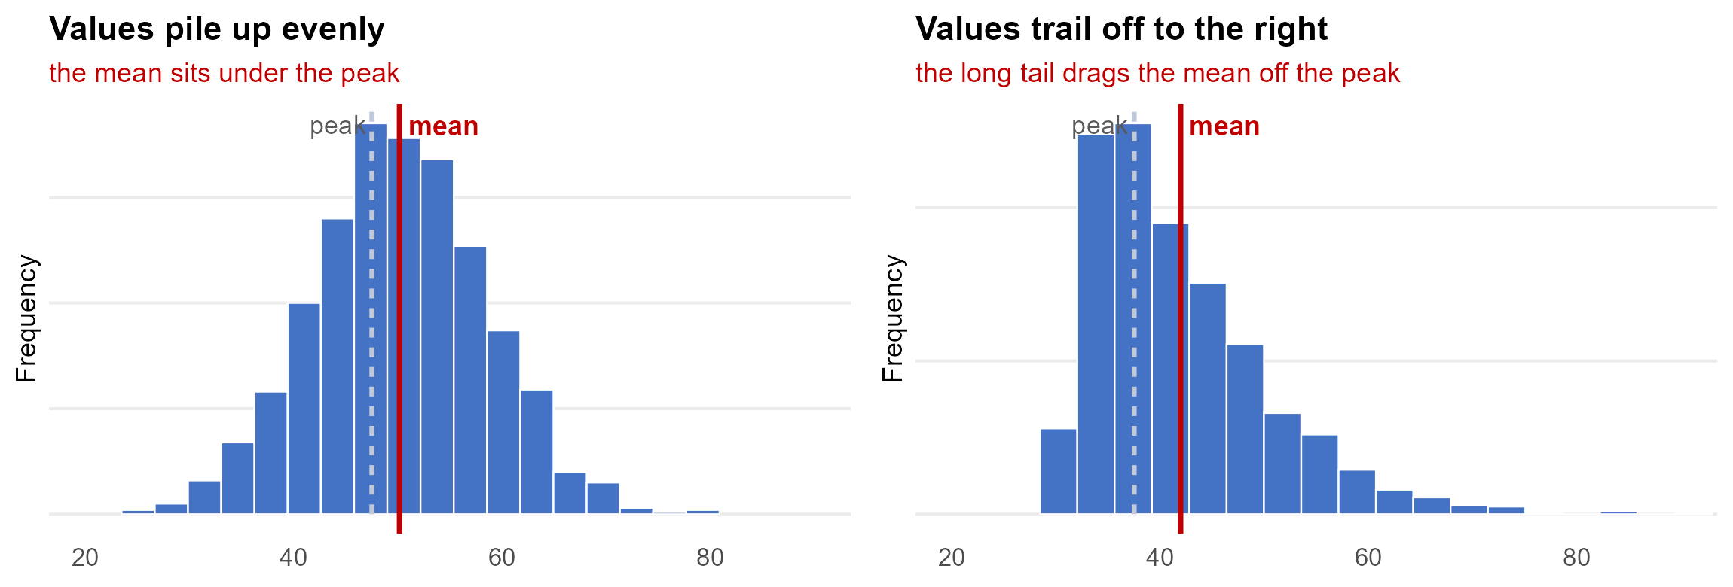
What to Look For: Center
Center – where is the middle of the distribution? Where does a typical value fall?
When the values pile up evenly the mean sits under the peak. When they trail off to one side the tail drags the mean away from where most of the data actually are. the mean alone can mislead.

Slide 9
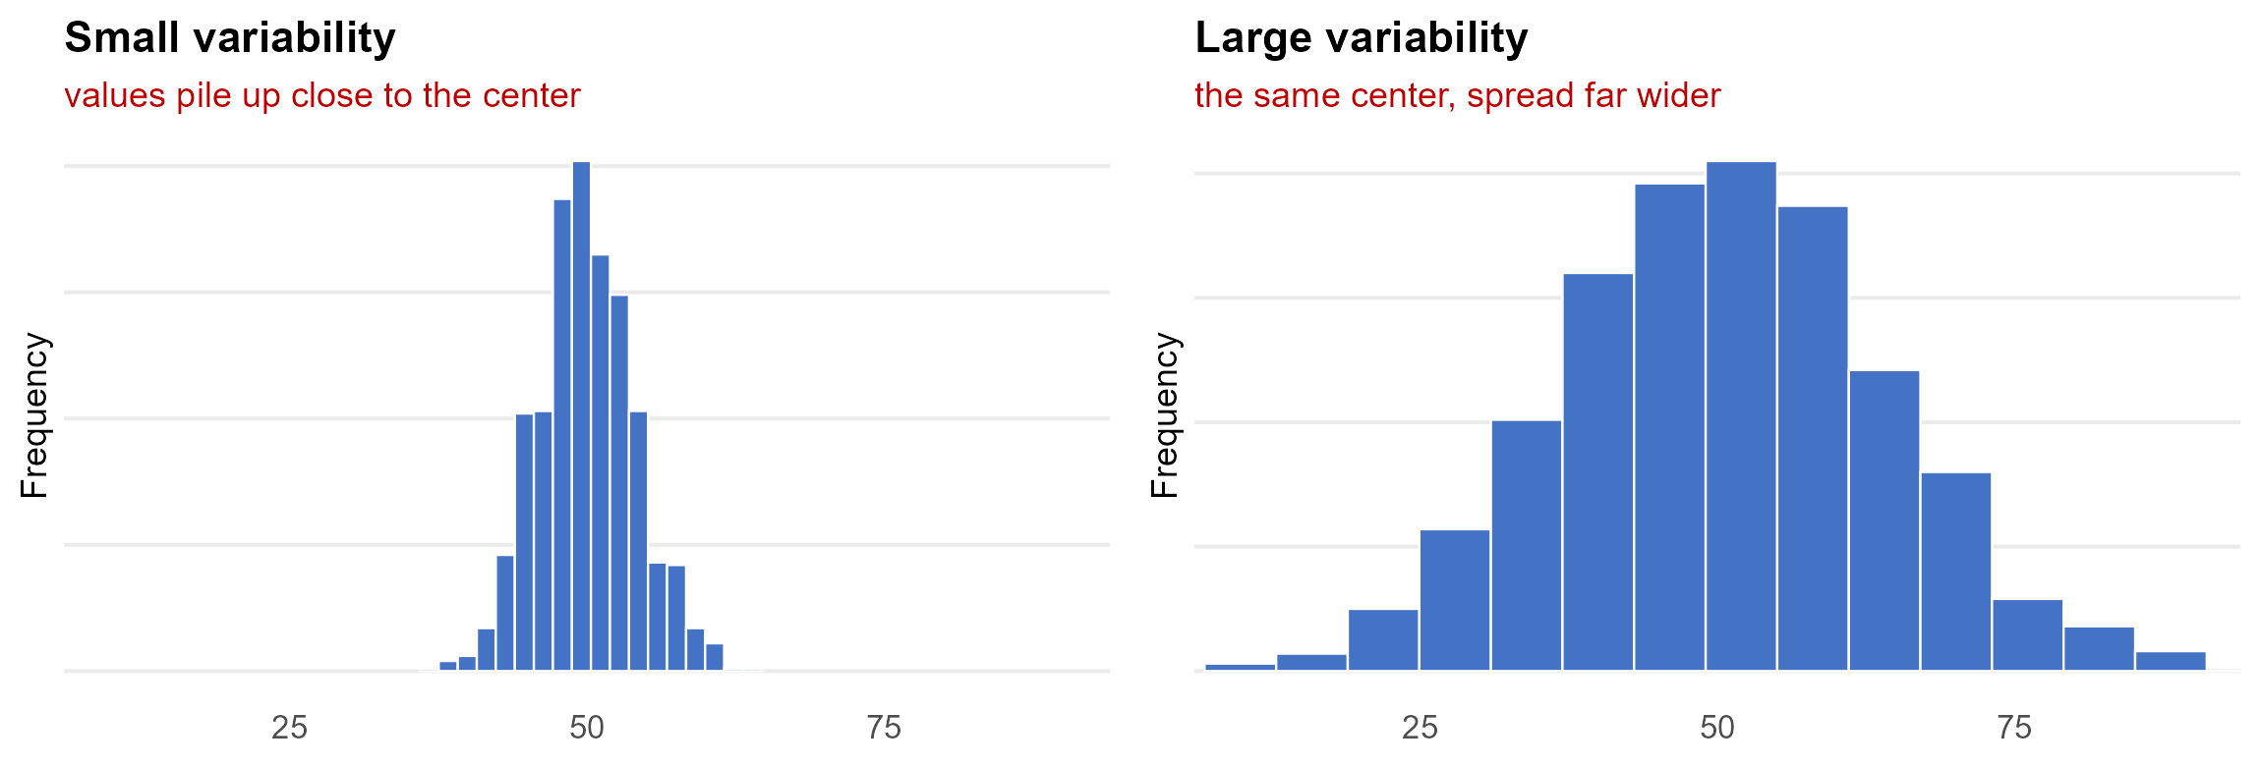
What to Look For: Variability
Variability – how tightly do observations cluster around the center of the distribution?
Both distributions have the same center, and the axes are identical. Everything that differs between these two pictures is variability: e.g how much the data spread out.

Slide 10
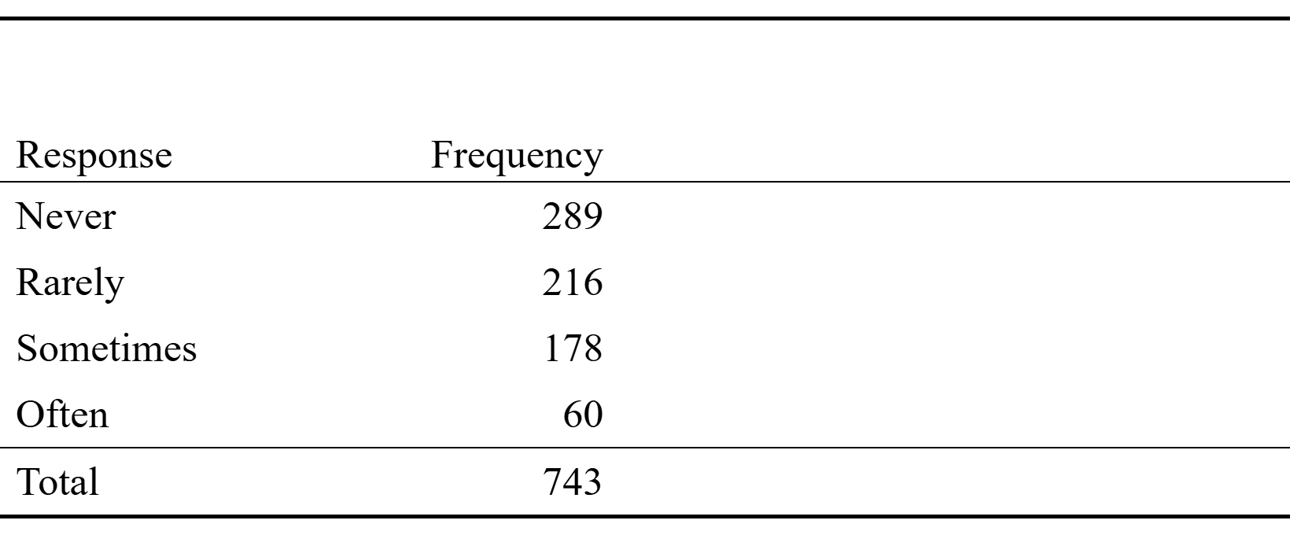
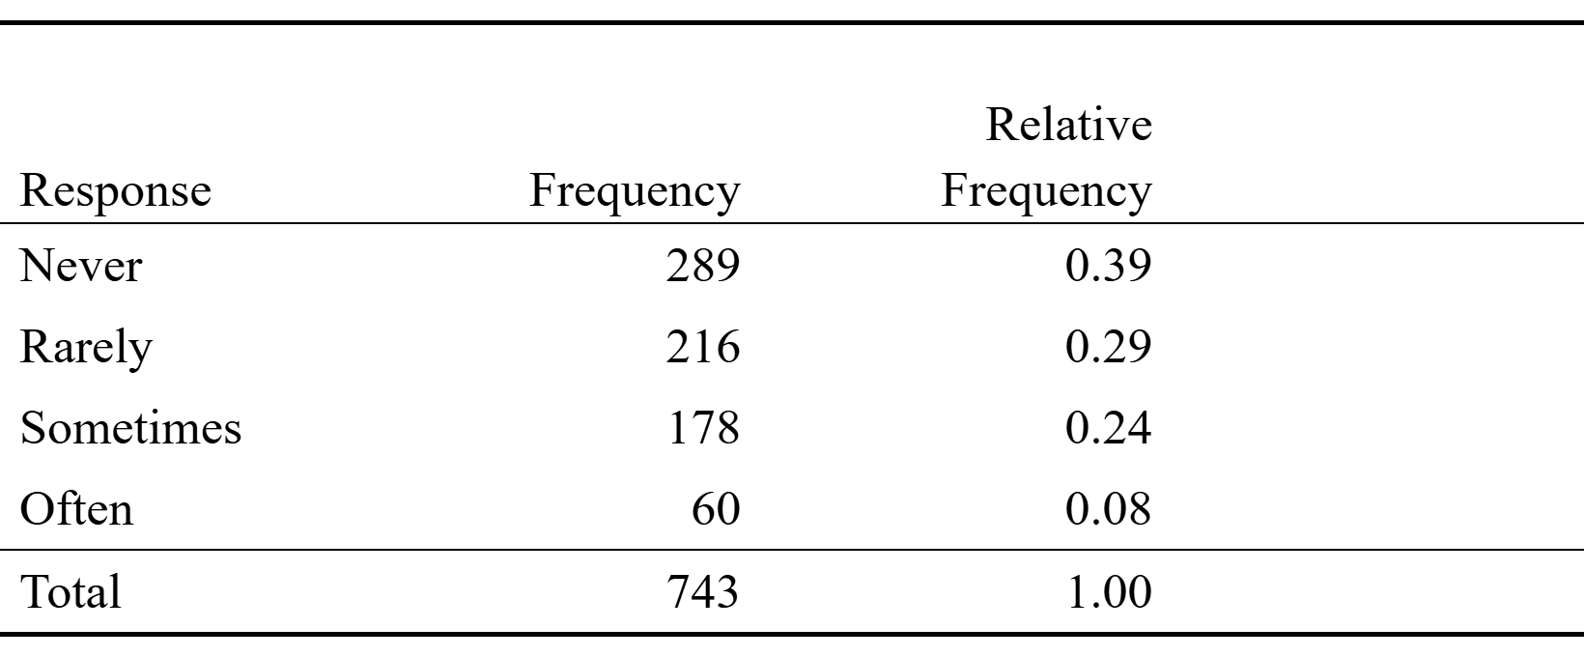
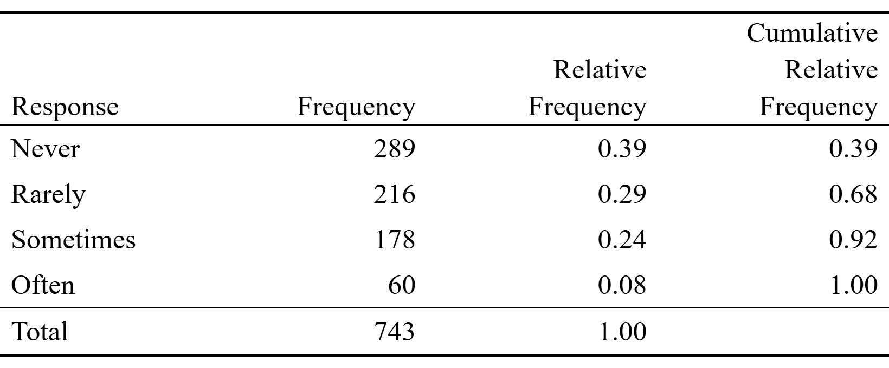
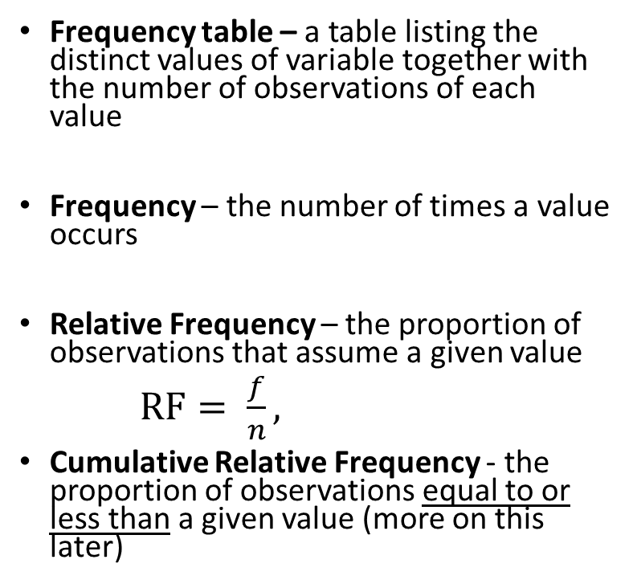
Displaying Distributions: Frequency Tables
Ex. Are teens distracted by their cell phones?
Frequency table – a table listing the distinct values of variable together with the number of observations of each value
Frequency – the number of times a value occurs
Relative Frequency – the proportion of observations that assume a given value
$RF= \frac{f}{n},$
Cumulative Relative Frequency - the proportion of observations equal to or less than a given value (more on this later)

Slide 11
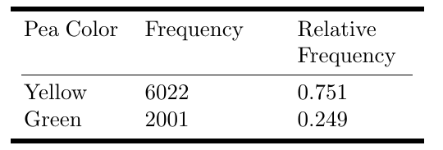
Example: Mendel’s Pea Plants
In one of Gregor Mendel’s classic studies he bred 8,023 pea plants and recorded the color of the peas – the seeds – that each plant produced.
Pea color is set by a single gene.
Yellow (Y) is dominant; green (y) is recessive. A plant is green only if it inherits y from both parents.
Cross two Yy plants and the offspring are YY, Yy, yY, yy in equal proportion – and only yy shows green. So the theory predicts 3 yellow to every 1 green.
Mendel counted 0.751 and 0.249 – almost exactly 3/4 and 1/4. A frequency table is doing real scientific work here.

Slide 12
Try it out: A Frequency Table by Hand
We put Pew's question to 20 students in this room: are you losing focus in class by checking your phone?
Sometimes Never Rarely Never Often
Rarely Never Sometimes Rarely Never
Sometimes Rarely Never Often Sometimes
Rarely Never Rarely Sometimes Never
Build the frequency table: frequency, relative frequency and cumulative relative frequency. Which is the modal category?
Response | f | Rel. freq. | Cum. rel. freq.
Never | 7 | 0.35 | 0.35
Rarely | 6 | 0.30 | 0.65
Sometimes | 5 | 0.25 | 0.90
Often | 2 | 0.10 | 1.00
Total | 20 | 1.00
Modal category: Never. Pew's 743 teens gave 0.39, 0.29, 0.24, 0.08 – 20 students landed within a few points of them.

Slide 13
Try it out: A Discrete Variable
Ten students report how many siblings they have. Writing the responses as a set:
R = {0, 1, 1, 2, 0,
3, 1, 2, 1, 4}
Build the frequency table. Which value comes up most often? Where do the values pile up, and how do they trail off?
R | f | Rel. freq.
0 | 2 | 0.20
1 | 4 | 0.40
2 | 2 | 0.20
3 | 1 | 0.10
4 | 1 | 0.10
Total | 10 | 1.00
The most common value is 1, but the mean is 1.5: the few large values pull the mean above where the bulk of the data sit – the same effect you saw on the center slide.

Slide 14
Frequency Tables for Continuous Variables
The number of possible values is usually very large
Convert continuous values into discrete groups (sometimes called bins):
Steps:
Divide the range of the variable into a set of non-overlapping intervals
Count the number of values that fall into each interval

Slide 15
Try it out: Binning a Continuous Variable
Fifteen observations of a continuous variable, written as a set:
X = {1.23, 1.38, 1.76, 2.60, 2.65,
2.79, 2.89, 3.12, 3.15, 3.18,
3.65, 3.77, 3.87, 4.12, 4.41}
No two values are alike, so listing them gives 15 values of frequency 1 and tells us nothing. Group them into whole-number bins.
Bin | f | Rel. freq.
1 ≤ X < 2 | 3 | 0.20
2 ≤ X < 3 | 4 | 0.27
3 ≤ X < 4 | 6 | 0.40
4 ≤ X < 5 | 2 | 0.13
Total | 15 | 1.00
Narrower bins | f | Rel. freq.
1.0 ≤ X < 1.5 | 2 | 0.13
1.5 ≤ X < 2.0 | 1 | 0.07
2.0 ≤ X < 2.5 | 0 | 0.00
2.5 ≤ X < 3.0 | 4 | 0.27
3.0 ≤ X < 3.5 | 3 | 0.20
3.5 ≤ X < 4.0 | 3 | 0.20
4.0 ≤ X < 4.5 | 2 | 0.13
Bin width is a choice, not a property of the data. Halving it splits the middle and exposes an empty bin: the values fall into two clusters.
Next: the same procedure on 272 Old Faithful eruptions.

Slide 16
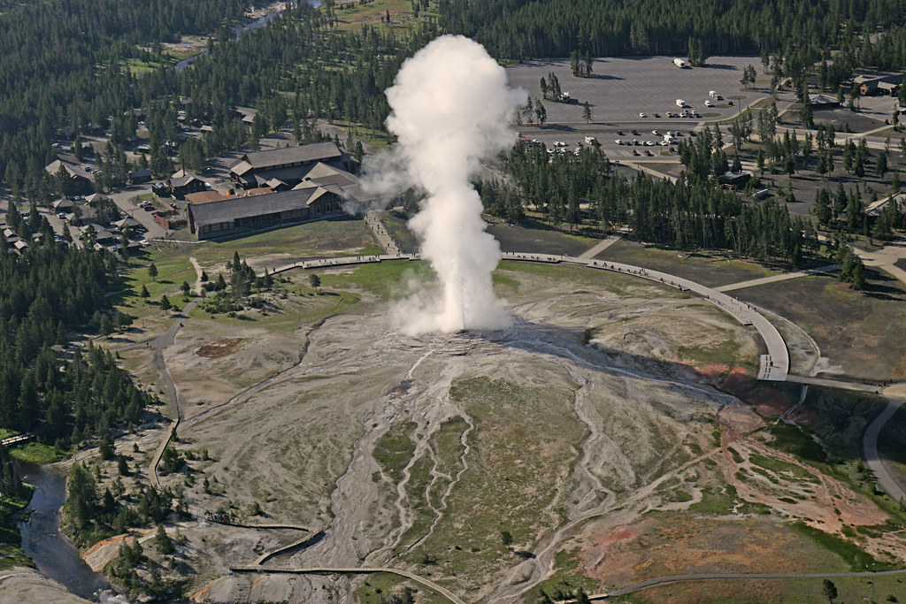
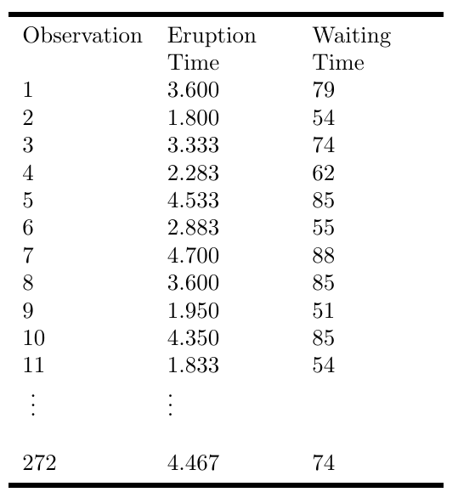
Example: Old Faithful Eruption Times

Slide 17
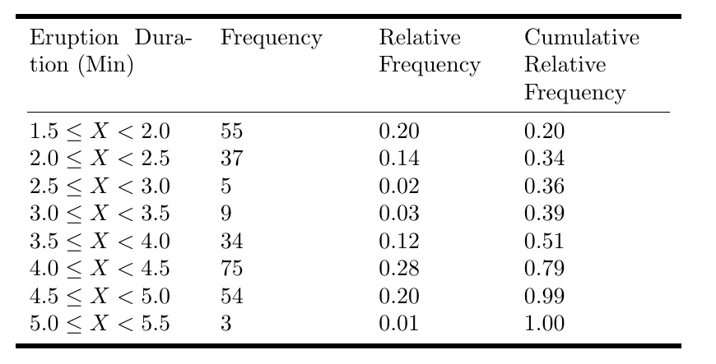
Old Faithful Eruption Times: Frequency Table

Slide 18
Graphical descriptions of data
Graphical Descriptions Of Data
Frequency Tables
Qualitative Variables
Quantitative Variables
Bar graph
Pie Chart
Pareto Chart
Dot Plot
Stem Chart
Histogram
Describe key features of the distribution
Modal Category
Shape
Center
Variability

Slide 19
Visualizing Distributions of Categorical Data
Pie Charts - a circle divided into ‘slices’ corresponding to each category. The size of a slice shows the proportion of observations in a category
Bar graph – displays a vertical bar for each category. The height of the bar shows the percentages of observations in the category
Pareto Chart - a bar chart with the categories ordered by decreasing frequency

